Slide 1

LEADING TOGETHER:
Governance That Transforms Districts
Texans for Excellence in Education Conference
April 17-19, 2026

Slide 2
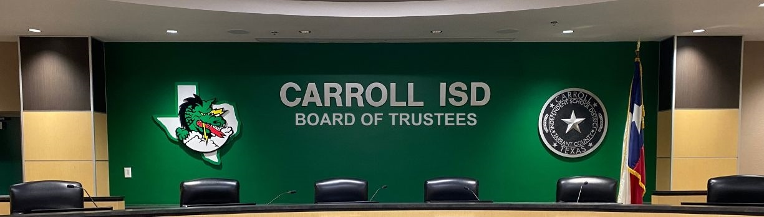
TRANSFORMATION IN PUBLIC EDUCATION
It starts in the Boardroom.
  Trust, Clarity of Roles, Shared Purpose, and Unity in Leadership

Slide 3

TOP CHALLENGES
  Increased political pressure
  Rapid cultural change
  Teacher shortages
  Accountability demands
  Financial constraints
4

Slide 4
GOVERNANCE
  STABILIZING Force
or
  DESTABILIZING force
5

Slide 5


STRONG GOVERNANCE
  Creates Continuity
  Protects the District
  Allows Superintendents to Lead
WEAK GOVERNANCE
Confusion
Turnover
Mistrust
5

Slide 6
OUR FOUNDATIONAL BELIEF
The Board:
The Superintendent:
GOVERNS
LEADS
6

Slide 7
THE BOARD AS A TEAM
Individual Trustees vs Boards

Slide 8
EFFECTIVE GOVERNANCE
“My Position”
“Our Direction”
to
8

Slide 9
THE BOARD’S RELATIONSHIP
WITH THE SUPERINTENDENT
9

Slide 10
THE BOARD TO SUPERINTENDENT RELATIONSHIP
  Professional
  Honest
  Goal-Driven
The quality of Board governance directly determines the quality of leadership a superintendent can provide.

Slide 11
WHEN BOARDS:
  Set clear goals
  Avoid micromanagement
  Provide consistent direction
SUPERINTENDENTS CAN:
  Focus on curriculum & instructional excellence
  Develop leaders
  Retain a strong staff
11

Slide 12
Carroll ISD Board of Trustees
Evaluates the superintendent based on district goals
Engages in strategic dialogue with the superintendent
Holds the superintendent accountable while giving him room to lead

Slide 13
GOVERNANCE PRACTICES

Slide 14
1
GOVERN THROUGH VISION, NOT REACTION
Boards that
spend their time:
While Boards that spend their time:
  Looking forward
  Monitoring progress
  & Aligning resources to priorities
  Reacting to emails
  Responding to social media
  & Revisiting past decisions
Tend to be
high-functioning
Tend to be
low-functioning

Slide 15
2
SPEAK WITH ONE VOICE
Alignment tends to build:
  Staff confidence
  Community trust
  District stability
Not being in alignment erodes all three.

Slide 16
3
INVEST IN YOUR BOARD
Boards that are successful:
  Train together
  Work together
  Evaluate themselves honestly

Slide 17
THE RESULTS SPEAK FOR THEMSELVES
Despite sustained financial challenges, continuing enrollment decline, and plans to close a campus, Carroll ISD continues to perform exceedingly well across all metrics.

Slide 18
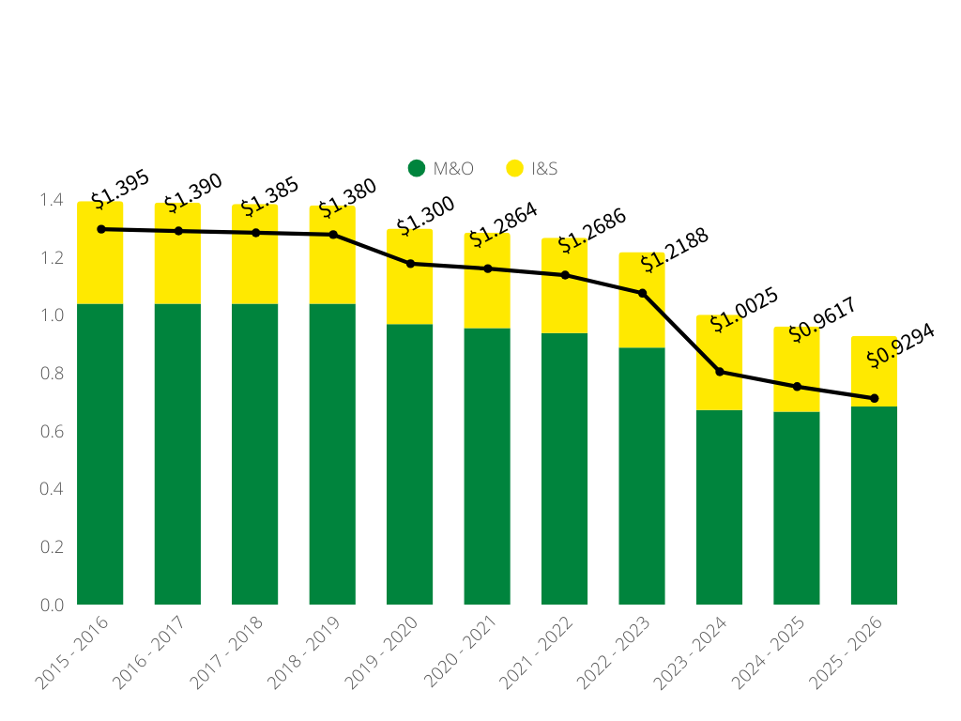
THE TOTAL TAX RATE HAS BEEN REDUCED BY MORE THAN 27% SINCE 2021.

Slide 19
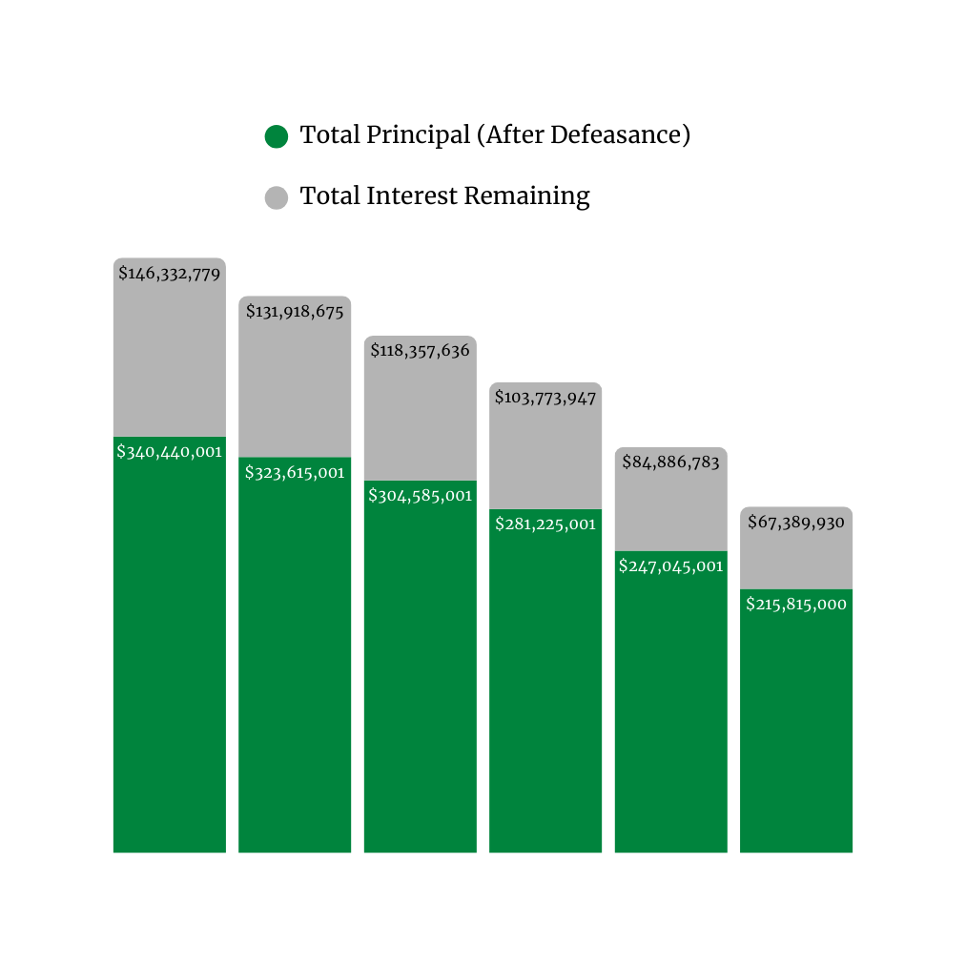


TOTAL DEBT SERVICE
$486,332,779
$455,533,676
$422,942,637
$384,998,948
$331,931,784
$283,204,930
Total debt service reduced:
$203,567,851
Principal: $124,625,001
Interest: $78,942,850
2020
2021
2022
2023
2024
2025

Slide 20
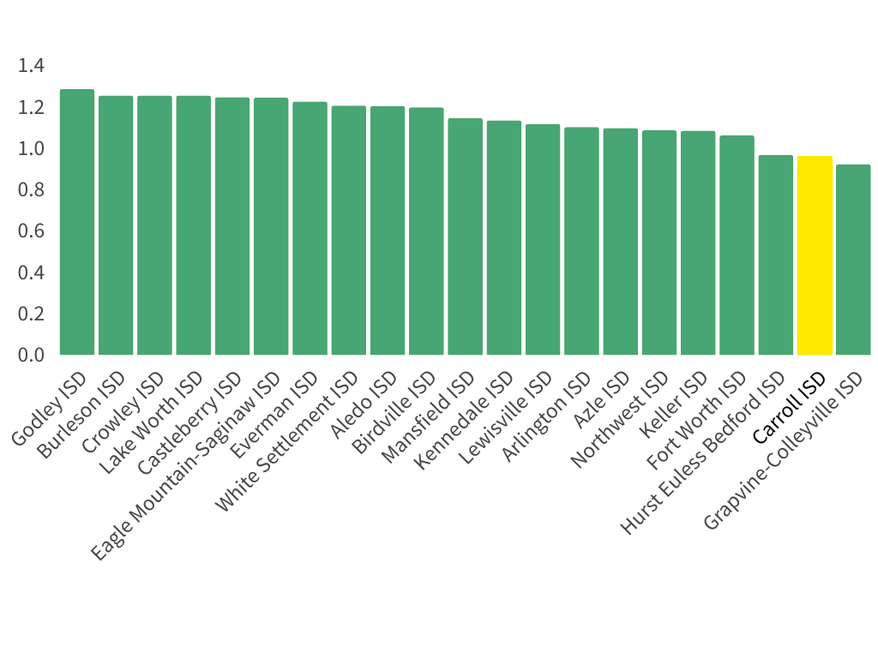
TARRANT COUNTY TAX RATE COMPARISON
Carroll ISD has among the lowest tax rates in Tarrant County.
Carroll ISD

Slide 21
FISCAL RESPONSIBILITY IDEAS FOR SCHOOL BOARDS
EXPENDITURE REDUCTIONS
  Administrative efficiencies (found savings of $1M year over year)
  Energy management plan
  Shopping for the best prices on labor and goods, and
  Streamlining operations to eliminate certain expenses
  Right-size physical plant to match student enrollment
REVENUE GENERATION
  Increase fees to move departments to being self-funded, eg: transportation, child nutrition, facilities rental fees, and pre-k fees
  Sell surplus properties, capacity adjustments to reduce operating expenses
  Create an endowment, use interest to fund staff and programs
  Partner with community for sponsorships, donations, and in-kind support
21

Slide 22
CARROLL ISD REMAINS A TOP DESTINATION DISTRICT IN THE STATE
The district continues to perform at top levels, with:
  Education Foundation donations up 359% since 2022
  2 Lone Star Cups and top three placement in the past five years
  Achieved all A’s across the district in TEA accountability ratings
Carroll ISD Report Card of Success

Slide 23

NATIONAL MERIT SCHOLARS
32 National Merit Finalists this year!
Over the past five years (school years 2022–2026), Carroll ISD has produced 155 National Merit Scholars, despite declining enrollment, lowering the tax rate, and implementing budget reductions.
In the previous five-year period (2017–2021), the district produced 97 National Merit Scholars.
We have been able to maintain our standards of excellence while upholding fiscally conservative values.

Slide 24
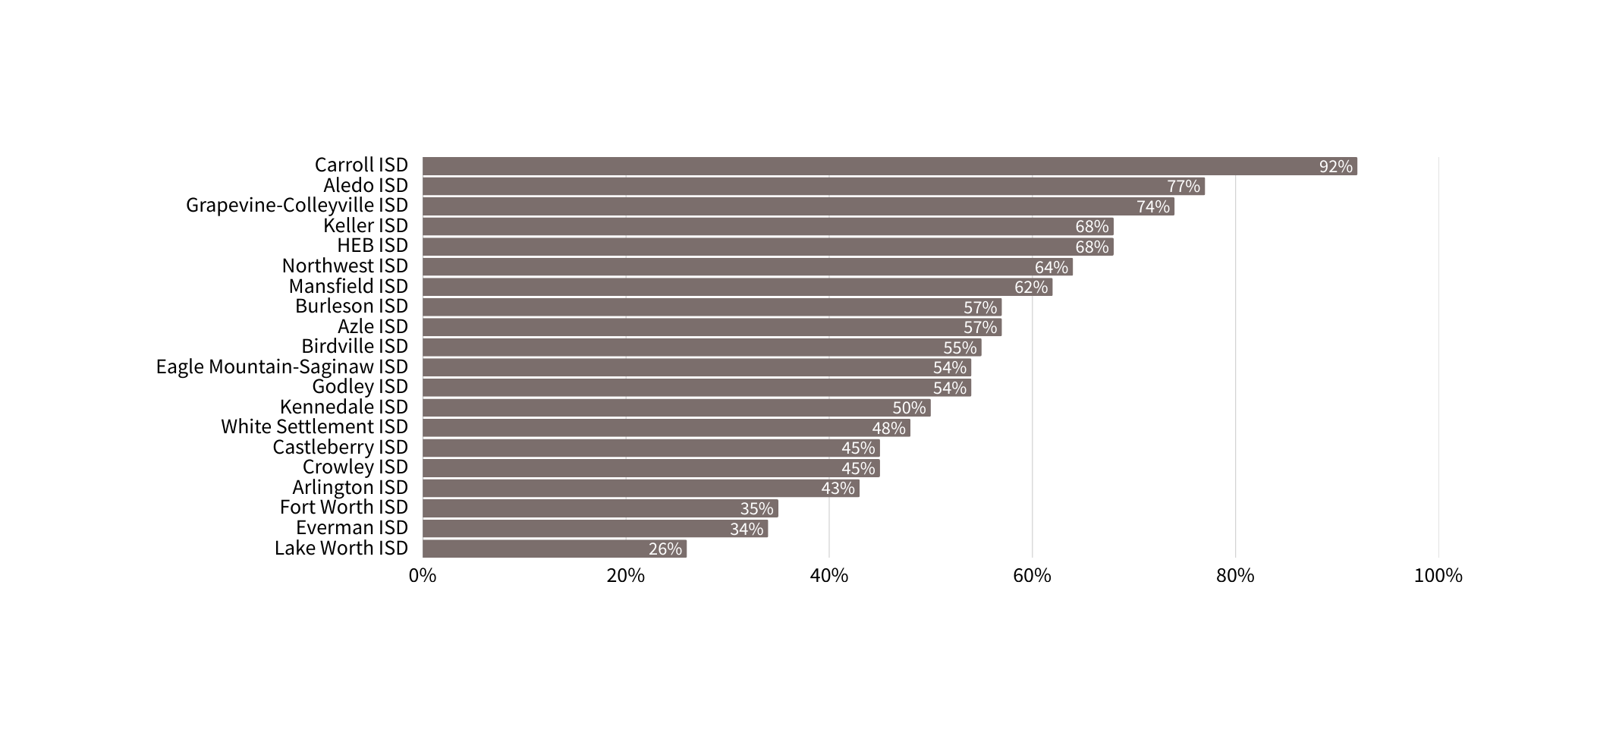
PERCENTAGE OF TARRANT COUNTY STUDENTS READING ON GRADE LEVEL BY ISD
Carroll ISD
92%
92%

Slide 25
WHEN BOARDS AND SUPERINTENDENTS LEAD TOGETHER:
  Students benefit
  Staff succeed
  Communities trust

Slide 26
THANK YOU
for joining us!
Any questions?

