Slide 1
The Interdependence of Energy, Economy, and Environment
The Governor’s Conference on Energy Governor of the Commonwealth of Virginia Bob McDonnell
Richmond, Virginia October 4, 2012
Kathleen Hartnett White Distinguished Senior Fellow and Director Armstrong Center for Energy and the Environment Texas Public Policy Foundation

Slide 2
The Relationship: Environment – Energy –Economy
More fruitfully viewed as mutually beneficial
As a policy objective and a historical fact!
A question of Interdependence not a balance.
The customary approach is “balancing” environmental protection with economic growth or energy production.
The approach typically assumes inherent conflict between environmental quality and economic productivity.

Slide 3
Environmental Protections and Economic Growth --- Inherent Conflict???
Not! Indeed, a remarkable environmental success story but rarely told!
Over the last three decades, industrial emissions of the six criteria pollutants under the CAA reduced by 60%.
While GDP increased 200%.
Emissions from mobile sources reduced by 90% while VMT increased 165%.
Toxic Emissions reduced 65% since 1990.
New coal-fired power plants – 90-95% less SO2.
1997- 113 urban areas non-attainment for ozone.
2011 – 30 urban areas non-attainment w/ fewer days of NAAQS exceedance
Houston Miracle – Attained the Ozone Standard 2009-2010.
Under existing regs, improving trends will continue w/ equipment turnover and refined technology.
Rarely heard but see EPA’s own data at at “Our Nation’s Air- Status and Trends 2012” and “Almanac of Environmental Trends” S. Hayward- AEI

Slide 4
Air Quality Improvement 1980-2010
 | Ambient 1980-2008 | Ambient 1980-2010 | Emissions 1980-2008 | Emissions 1980-2010
Carbon Monoxide (CO) | -79% | -82% | -58% | -71%
Ozone (O3) | -25% | -28% | -49% | NCD
Lead (Pb) | -92% | -90% | -96% | -97%
Nitrogen Dioxide NO2 | -46% | -52% | -40% | -52%
Particulates (PM10)* | -31% | -38% | -46% | -83%
Fine Particulates (PM2.5)** | -21% | -27% | -36% | -55%
Sulfur Dioxides (SO2) | -71% | -76% | -56% | -69%
NCD- No Current Data
*1990-2010
**2000-2010
Source: U.S. Environmental Protection Agency, "Air Quality Trends," January 2012, at http://www.epa.gov/airtrends/aqtrends.html (April 18, 2012).

Slide 5
“The Learning Curve is Green” – Warren Brookes
The U.S. has developed the know-how to expand energy production and processing while minimizing environmental impact
EPA and state regulation played a significant role but private business got it done
Competitive market place catalyzed innovative technologies….of which we now have a slew
Operational efficiencies to avoid costly wastes conserved energy and reduced emissions
US now gets far more output with less (energy) input
Prosperity provided the capital for huge investment in environmental controls
Prosperity enabled consumers to replace vehicles and appliances
Vilification of coal is unjustified. $100 billion invested in emission controls.
New is perforce cleaner. Natural turn-over will keep reducing emissions

Slide 6
Interdependence of Economic Growth and Environmental Improvement – Historical Fact
History across the world shows that environmental protection depends upon economic growth.
Environmental Performance Index (Yale), Index of Economic Freedom (WSJ/Heritage Foundation) Fraser Institute
Consistently demonstrate strong correlation between economic growth and environmental performance
Environmental Quality remains unaffordable luxury for most of the developing world
Energy is master resource (J. Simon)- acts as economy’s nervous system
60% of India’s population has no access to electricity
Contaminated drinking water and sewage – the world’s largest killers
Drinking water and wastewater treatment requires electricity

Slide 7
“Energy is the Master Resource” - Julian Simon (Economist)
Energy’s dynamic, omnipresent role in the economy is remarkably misunderstood
Energy operates in the economy like the nervous system in the human body
Price of energy is imbedded in all goods and services
Our enviable “quality of life” depends on access to abundant, affordable reliable energy

Slide 8
The U.S. now has access to vast energy resources …
Upsurge in U.S. Energy Production of global geo-political and economic importance.
Not a volatile boom but long-term viability
Saudi Arabia’s Aramco admits the world’s energy axis has shifted to North America
After 40 years of federal regulatory constraints and six presidents’ promise of energy independence
U.S. could be largest producer of oil and natural gas in the world and accidentally independent before 2020
A result of private sector innovation-no public investment needed!
Hydraulic fracturing, horizontal drilling, micro-seismic imaging – precision
U.S. has always been the Saudi Arabia of coal

Slide 9
The U.S. Energy Upsurge
2010 some Texas refineries processed 80 % imported and 20% domestic oil
2012 same refineries process 85% oil made in the USA
Midland Texas now tied with Bismark, ND for the lowest unemployment rate in the country
Texas expects a budget surplus of $4 billion plus
First energy driven Texas surplus since the late 1960’s

Slide 10
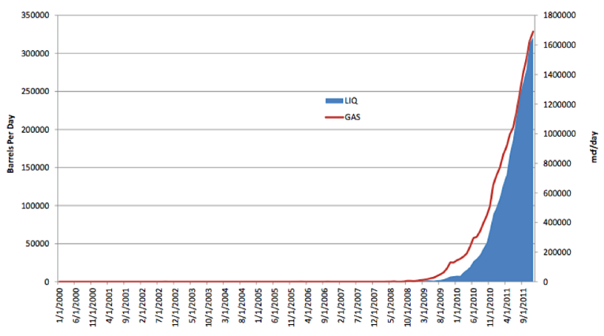
Eagle Ford Production Growth 1/2010 – 9/2011
Source: HPDI March 21, 2012

Slide 11
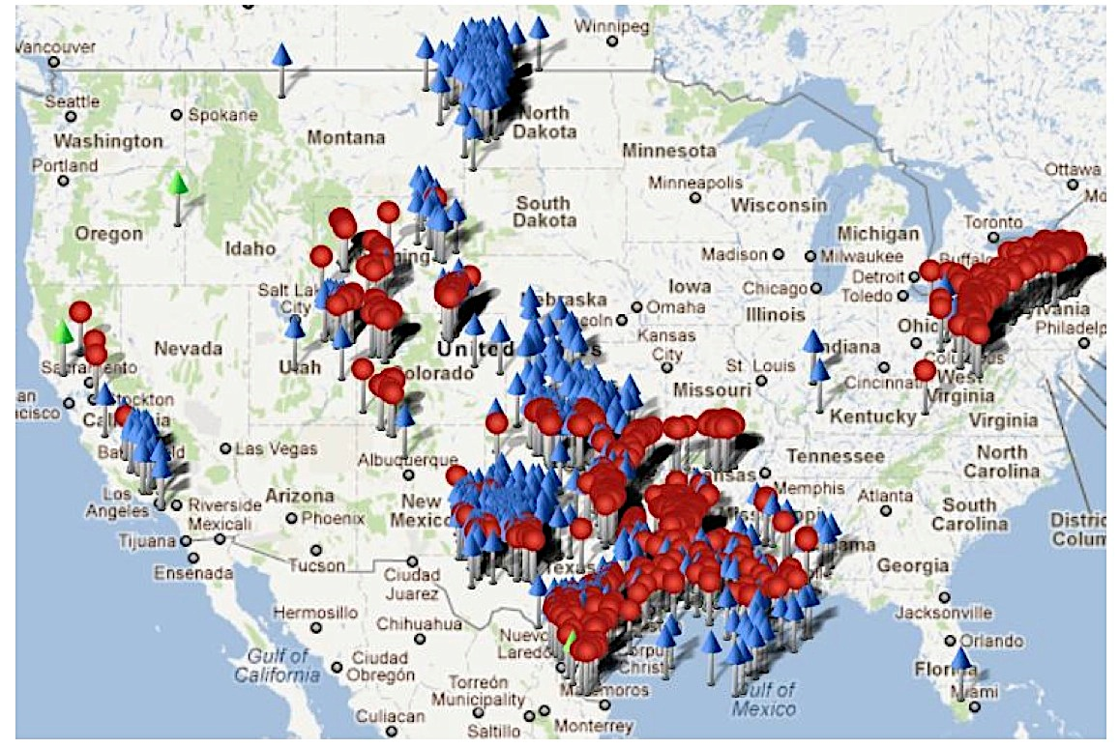
Rig Count and Permits
Source: Baker Hughes Interactive Rig Count Jan 25, 2012

Slide 12
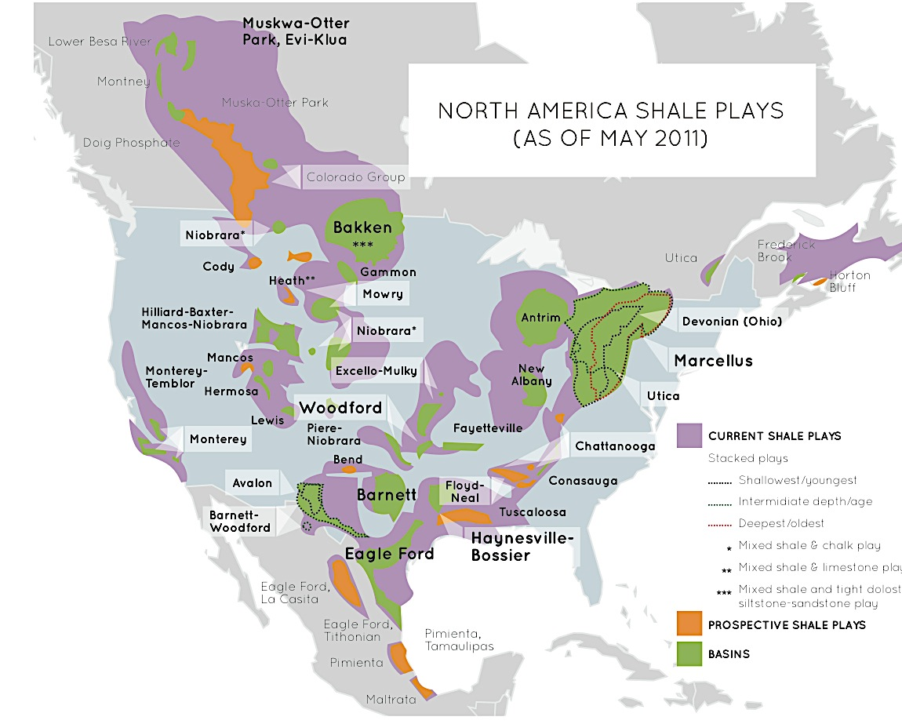
Source: U.S. Energy Information Administration Based on Data From Various Published Studies. Canada and Mexico Plays From ARI. Last Updated: May 9, 2011

Slide 13
Energy Diversity = Energy Resilience
Diverse energy sources competing in the market place – best assurance of affordable, reliable, abundant energy
Coal is an essential mainstay in U.S. Energy Portfolio
Low Natural Gas Prices not merely a question of supply
Will they last ? LNG Terminals now plan export instead of import
Natural Gas prices in U.S. now $3mbtu ; India- $15; China- $12
Let renewables find their niche in the energy market place without mandate or subsidy

Slide 14
Renewables
Renewables not on the cusp of deployment at scale
Inherently less dense, efficient, reliable and are parasitic on reliable generation
Texas has over 10,000 MW installed wind capacity; 3000 miles of new line.
Wind generators increasingly selling negatively but still profitable w/ generous PTC
Negative Pricing confounds the entire electric market
See “Negative Electric Prices and the Production Tax Credit “ Northbridge Group

Slide 15
The Regulatory Challenge
Dizzying pace and volume of production merit increased regulatory oversight
Crucial that existing state and regional authority is maintained.
Strategic design, neither over or under regulate, hit the target
Measure cumulative impacts and effectiveness
States have primary authority under existing law but current EPA veers toward ‘federalizing fracking’
New EPA NSPS NESHAP adopted August 2012 – unprecedented

Slide 16
Monitors Trump Models
Spend the $$$ and time to inventory risks by measured assessments - not worst case modeled scenarios
EG Texas in the Barnet Shale- physical measurement by ambient monitors and extensive representative air samples
Emissions far less than initially modeled
Barnet Shale wells went from a handful to 14,000 in 3 years

Slide 17
Regulators should act on fact not fear.
One-Size Does Not Fit All - Broad diversity in upstream operations. Thousands of small independents and only a handful of “majors”
Upstream oil and gas production historically not a major source of emissions, nor water quality contamination, nor groundwater depletion. Volume of activity in certain regions calls for greater regulatory scrutiny
New regs or greater enforcement of existing regs
Utilize Performance Measures and bright lines
Educate the public
Use Inter-agency efforts to streamline permitting, state oversight and compliance
States will provide more environmental protection than federal drivers Pragmatic, creatively designed regulations
Industry and local communities as partner with the regulator
Aim for the win-win

Slide 18
How could we turn down the game-changing energy potential of the U.S.?
National Security- eliminate energy dependence on hostile nations.
Renaissance of U.S. Manufacturing- Already a new steel plant in Ohio to manufacture fracking hardware Philadelphia Shipyard –oil tanker construction Chemical industries surging with low natural gas prices
Job creation- potential -2-6 million nationwide
Affordable energy- to reverse the trend of sharply rising energy costs Energy poverty is here and getting worse Median income families pay 21% of disposable income on energy Slightly more than for food – together <42% of income
State and federal revenues- under existing tax rates
Deficit reduction – a financially painless means

Slide 19
Comparison of Reduction Crime, Welfare, Pollution
Source: FBI, EPA, HHS

Slide 20
Environmental Optimism is Realistic
“On what principle is it that, when we see nothing but improvement behind us, we are to expect nothing but deterioration before us?” - T. Macaulay, 1830
Human life-span in the U.S. has increased 70% in the last century

